Slide 1
ECMAScript 6 数组扩展
崔健
cuijian03@baidu.com
地图开放平台业务部

Slide 2
数组扩展
ES6对于Array的扩展主要是对一些常用的操作提供了原生的支持。ES7的扩展则更加诱人一些。
ES6:
  Array.from()
  Array.of()
  find(), findIndex()
  fill()
  entries(), key(), values()
ES7:
  Includes()
  数组推导
  Array.observe(), Array.unobserved()

Slide 3
Array.from():转换类数组为真正的数组
Array.from(arrayLike[, mapFn[, thisArg]])
arguments
nodelist
带length的Object
set和map
string

Slide 4
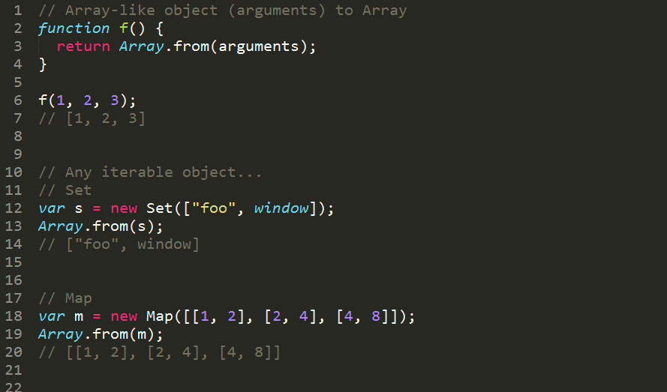

Slide 5
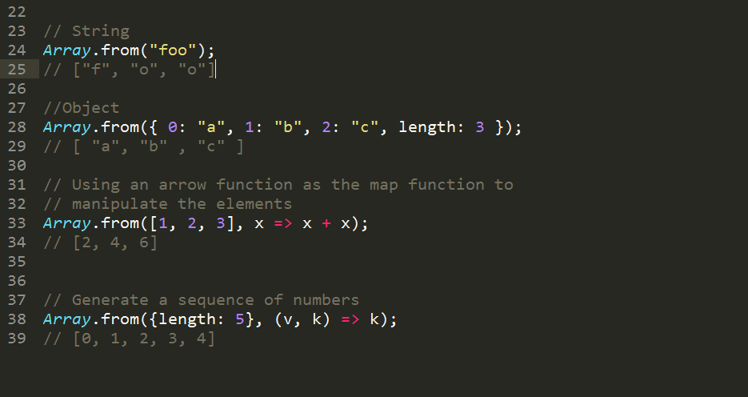

Slide 6
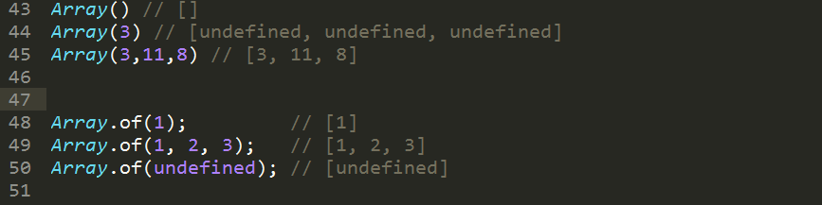
Array.of():将一组值转换为数组
Array.of(element0[, element1[, ...[, elementN]]])

Slide 7
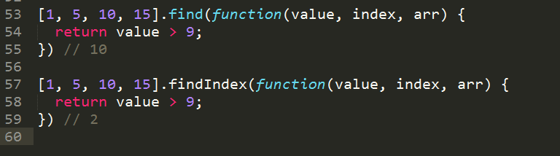
find() findIndex() :查找匹配项
arr.find(callback[, thisArg])
arr.findIndex(callback[, thisArg])
callback(element, index, array)

Slide 8
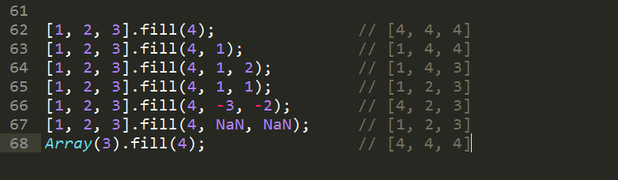
fill() 填充数组
arr.fill(value[, start = 0[, end = this.length]])

Slide 9
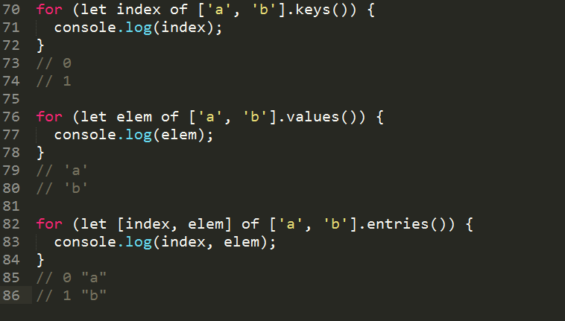
entries(), keys(), values() 遍历数组
arr.entries(),arr.keys(),arr.values()

Slide 10
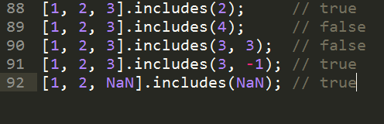
includes() 检查是否包含给定值
array.includes(searchElement[, fromIndex])

Slide 11
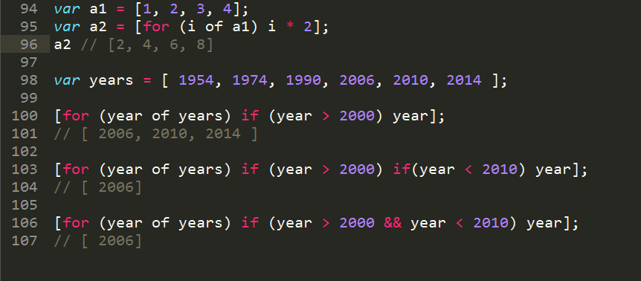
数组推导 简洁推导方法

Slide 12
Array.observe(),Array.unobserve() 监听
Array.observe(arr, callback)
Array.unobserve(arr, callback)

Slide 13
Array.observe(),Array.unobserve() 监听
callback
  The function called each time changes are made, with the following argument:
  changes
    An array of objects each representing a change.
    The properties of these change objects are:
        name: The name of the property which was changed.
        object: The changed array after the change was made.
        oldValue: Only for "update" and "delete" types. The value before the change.
        index: Only for the "splice" type. The index at which the change occurred.
        removed: Only for the "splice" type. An array of the removed elements.
        addedCount: Only for the "splice" type. The number of elements added.
        type: A string indicating the type of change taking place. One of "add", "update", "delete", or "splice".

Slide 14
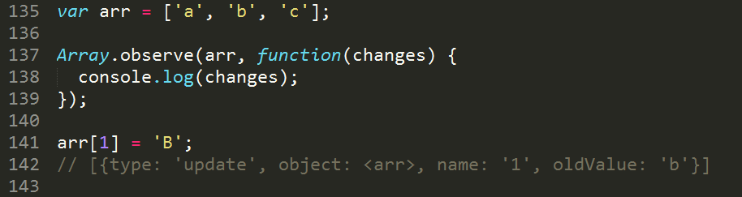
Array.observe(),Array.unobserve() 监听

Slide 15
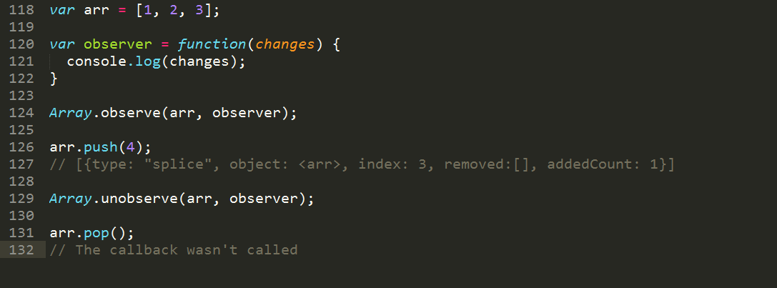
Array.observe(),Array.unobserve() 监听

